Slide 1




The Cartesian Plane
5
-5
5
-5

Slide 2




Imagine the top surface of your desk stretching in every direction.
If it continued to spread , it would go right through your neighbor . . .
. . . and then through the classroom walls . . .

Slide 3

. . . and through the school and the hills and the mountains and out into space until it went on forever in every direction.
Then you would have a plane.

Slide 4
In mathematics, a plane is a flat surface that goes on forever in every direction.
In Algebra, we often use the cartesian plane.

Slide 5
The cartesian plane is divided by two number lines. One is horizontal, like the number line you already know.
-10
-5
0
5
10

Slide 6
The other is vertical, with up being the positive direction and down being the negative direction.

Slide 7
5
-10
-5
0
5
10
-5

Slide 8
The cartesian plane is filled with points . . .

Slide 9
. . . infinitely many points.
And somewhere among all those points is the point we call the origin.

Slide 10
The origin is the point where the two number lines meet.
5
0
-10
-5
5
10
-5

Slide 11
The two number lines have special names.
5
The horizontal number line is called the x-axis.
0
-10
-5
5
10
The vertical number line is called the y-axis.
-5

Slide 12


The plural of axis is axes. We often talk about the coordinate axes.
5
0
-10
-5
5
10
-5

Slide 13
To study a point, we need to know where to find it. So we give it coordinates.
Coordinates are like an address. They tell you how you can get to a point if you start at the origin.

Slide 14
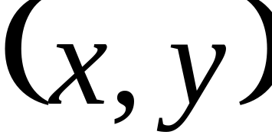
Coordinates are always written in parentheses, with the x-value first.
5
0
-10
-5
5
10
-5

Slide 15
Coordinates written in parentheses are called an ordered pair.
5
0
-10
-5
5
10
-5

Slide 16
Consider the point which has coordinates, (4, -2).
So the 4 in (4, -2) says we need to move 4 units to the right.
5
0
-10
-5
5
10
The first number tells you how far to move along the x-axis.
Remember to start at the origin!
-5

Slide 17

The second number tells you how far to move up or down.
The –2 in (4, -2) tells you to move down two units.
5
0
-10
-5
5
10
-5

Slide 18
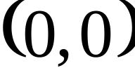
To get to the origin from the origin, we don’t move at all.
So the origin is designated by the ordered pair, (0, 0)
5
0
-10
-5
5
10
-5

Slide 19
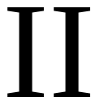


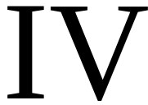
In Quadrant II, x-values are negative, while y-values are positive.
In Quadrant I, all values are positive.
The two number lines divide the plane into four regions.
We call the regions quadrants.
5
0
-10
-5
5
10
Quadrants are labeled with Roman Numerals.
In Quadrant IV, x-values are positive and y-values are negative.
In Quadrant III, x- and y-values are both negative.
-5

Slide 20
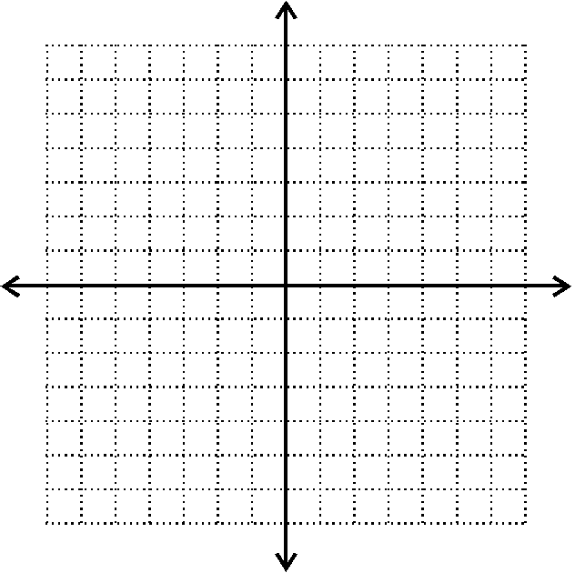
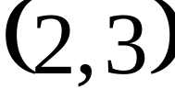
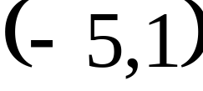
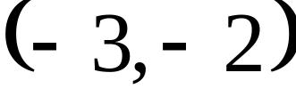
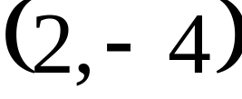
Give the coordinates of each point:

Slide 21
Plot each point and describe how to get to the point from the origin.
From the origin, move to the right 8 units, then down 7 units.
(8,–7)
(4,0)
(–4,–5)
(0,–9)
(7,12)
From the origin, move to the right 4 units, then stop (Stay on the x-axis.).
From the origin, move to the left 4 units, then down 5 units.
From the origin, don’t move to the right or left (stay on the y-axis), then move down 9 units.
From the origin, move to the right 7 units, then up 12 units.

Slide 22
Use your own words to explain what each term means:
Origin
Quadrant
Axis
Coordinates
Ordered pair

